Slide 1

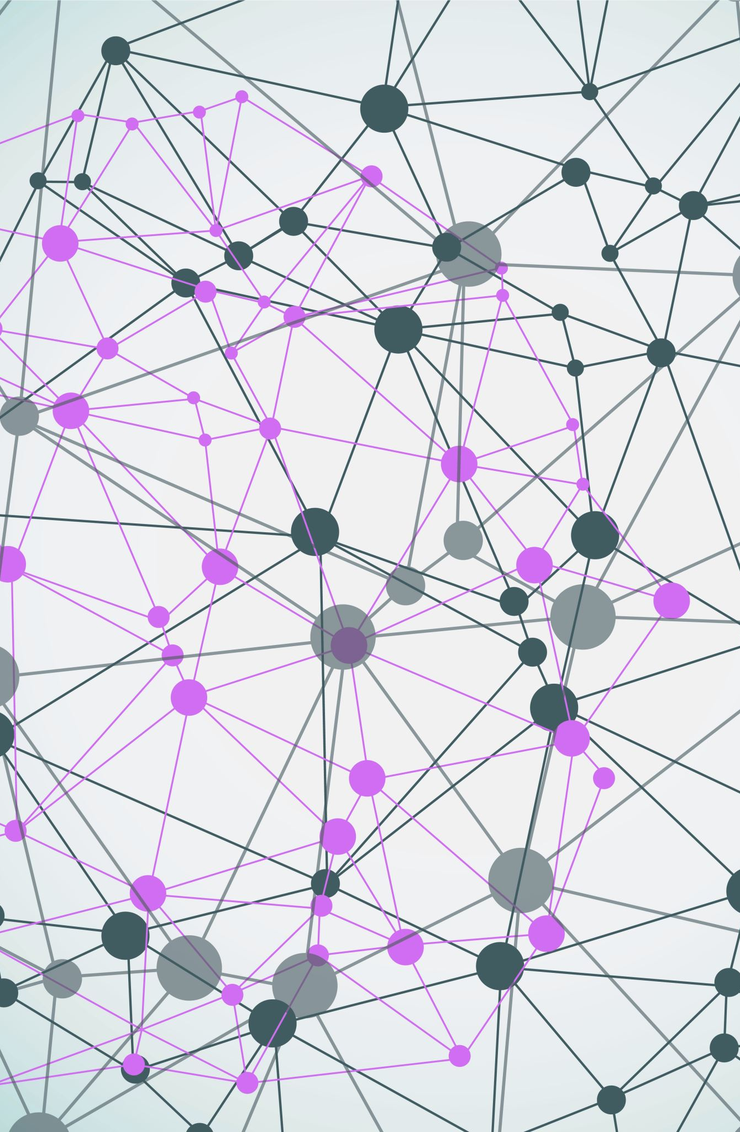
Iris Flower Data Set
Made By:
Name: Charan Pakala
Course : B.Tech CSM (2nd year)
ANITS, Visakhapatnam

Slide 2
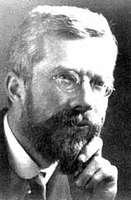




The Iris flower data set or Fisher's Iris data set is a multivariate data set introduced by Ronald Fisher in his 1936. It is sometimes called Anderson's Iris data set because Edgar Anderson collected the data to quantify the morphologic variation of Iris flowers of three related species. The use of this data set in cluster analysis ıs however uncommon, since the data set only contains two clusters with rather obvious separation.

Slide 3
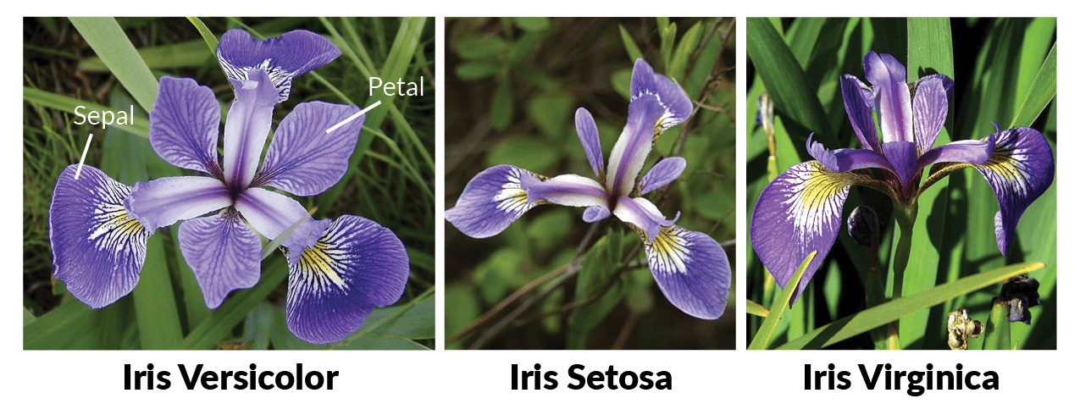
One of the clusters contains Iris setosa, while the other cluster contains both Iris virginica and Iris versicolor and is not separable without the species information Fisher used. It is multivariate(more than 2 dependent variable) data set Study of three related Iris flowers species. Data set contain 50 sample of each species(Iris-Setosa, Iris-Virginica, IrisVersicolor)

Slide 4
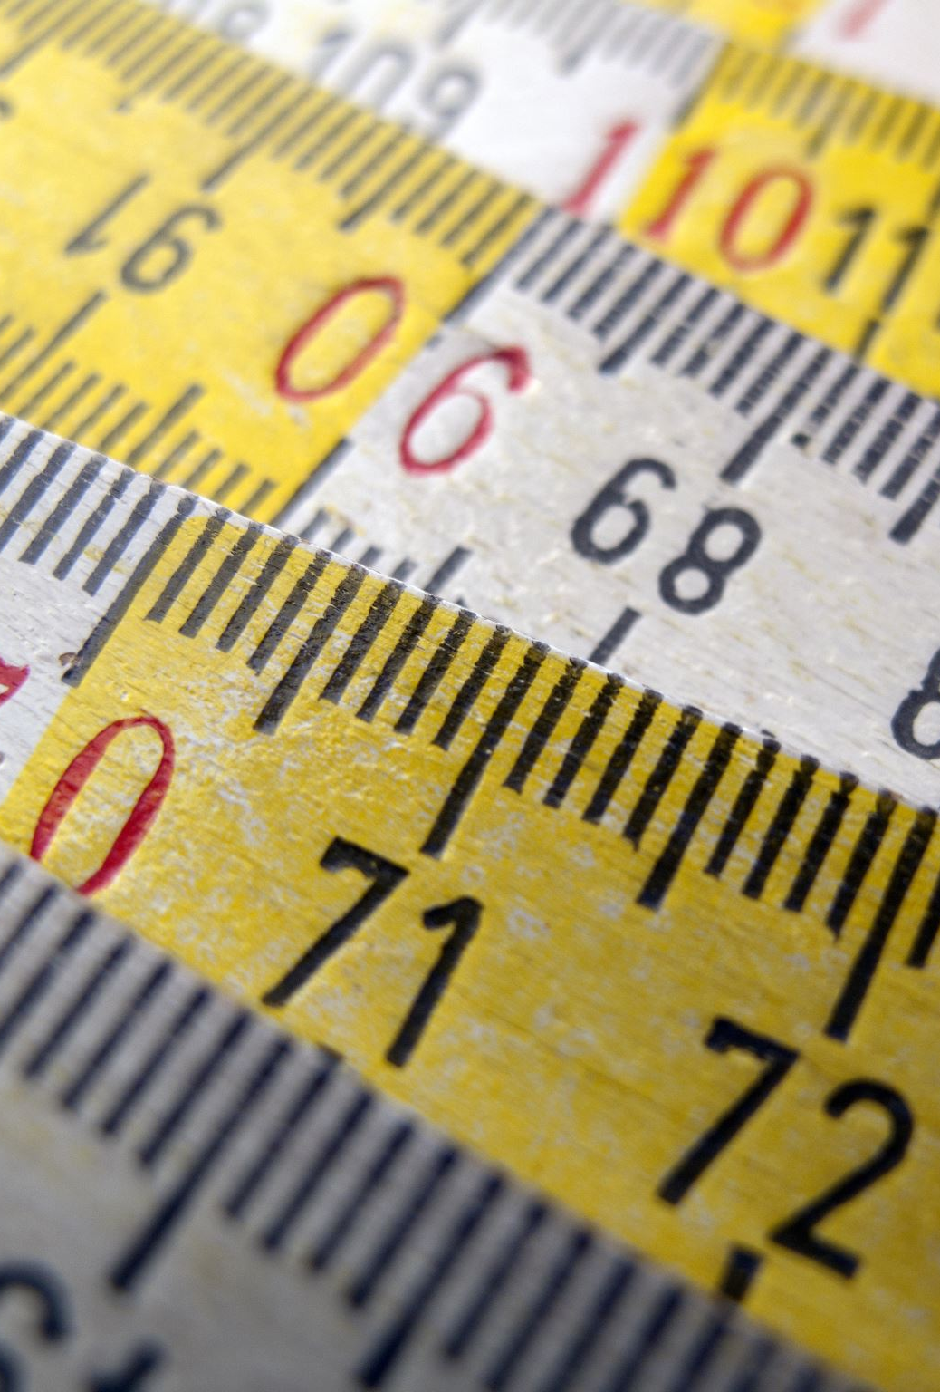
Features Used : 1. Sepal length in cm 2. Sepal width in cm 3. Petal length in cm 4. Petal width in cm

Slide 5

Data Analysis : 1. Descriptive statistics- SD, Min, Max etc . 2. Class Distribution (Species counts are balanced or imbalanced) – Balanced. 3. Univariate Plots:- Understand each attribute better.

Slide 6
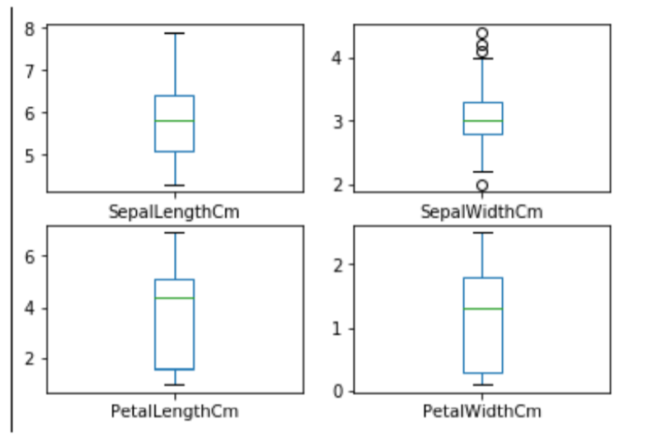
Box and whisker plots(Give idea about distribution of input attributes)

Slide 7
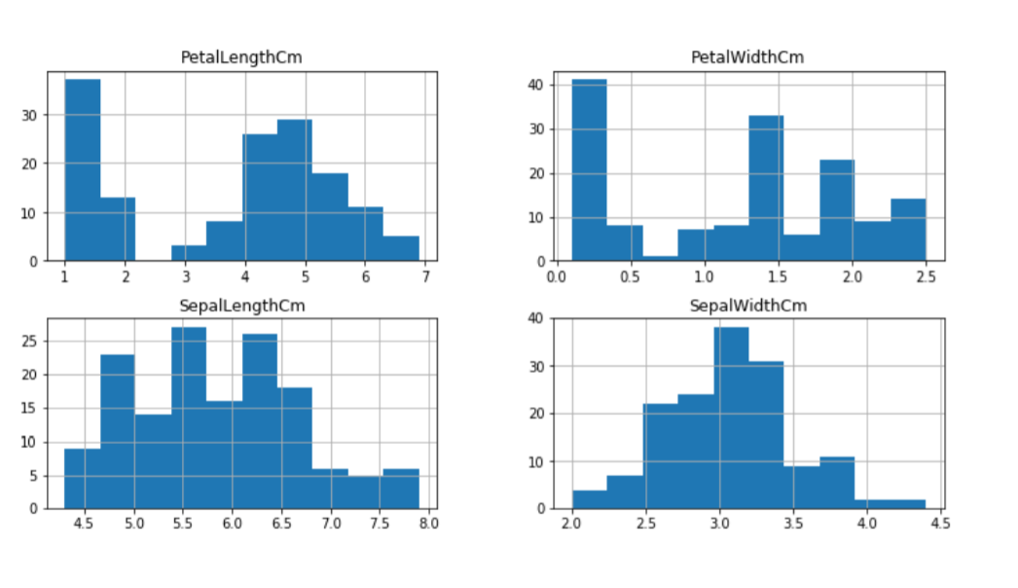
Plotting Histogram:

Slide 8
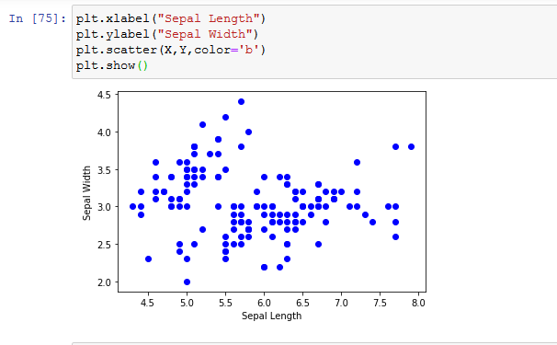
Plotting Scatter Graph Between Sepal Length and Sepal Width:

Slide 9
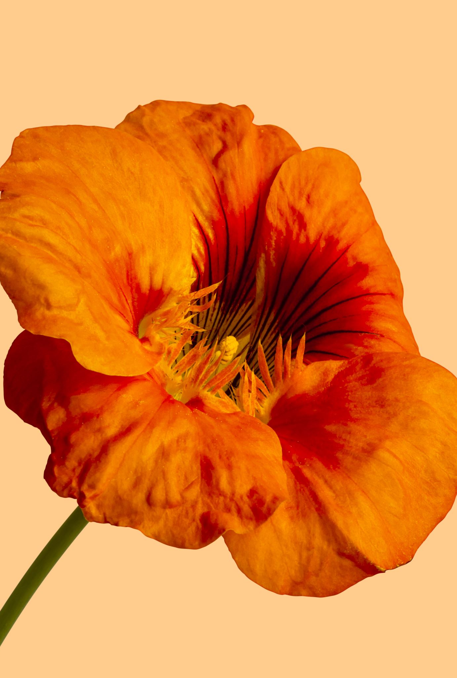
Observation: 1. Using Sepal_Lenght & Sepal_Width features, we can only distinguish Setosa flower from others. 2. Seperating Versicolor & Virginica is much harder as they have considerable overlap. 3. Hence, Sepal_Lenght & Sepal_Width features only work well for Setosa.

Slide 10
Implementation of Machine Learning.

Slide 11
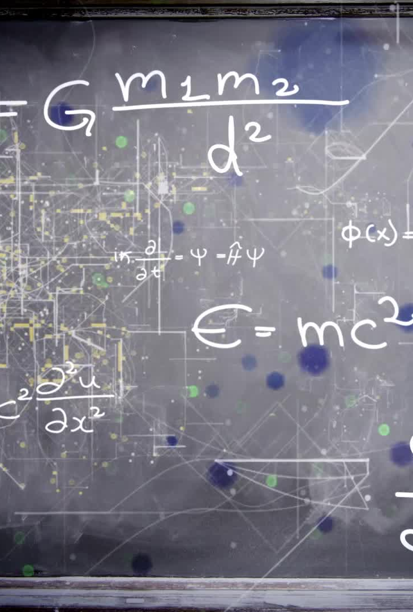
Steps to implement Machine Learning 1. Import Library 2. Analyze Data 3. Spliting the Data Set into train and test 4. Chossing right algorithm for training model 5. Test the algorithm with test data.

Slide 12

Algorithms Used: 1. Logistic Regression 2. Support Vector Machine 3. Classification and Regression Tree(CART) 4. Gaussion Naive Bayes(NB) 5. K-Nearest Neighbour(KNN) 6. Deision Tree

Slide 13
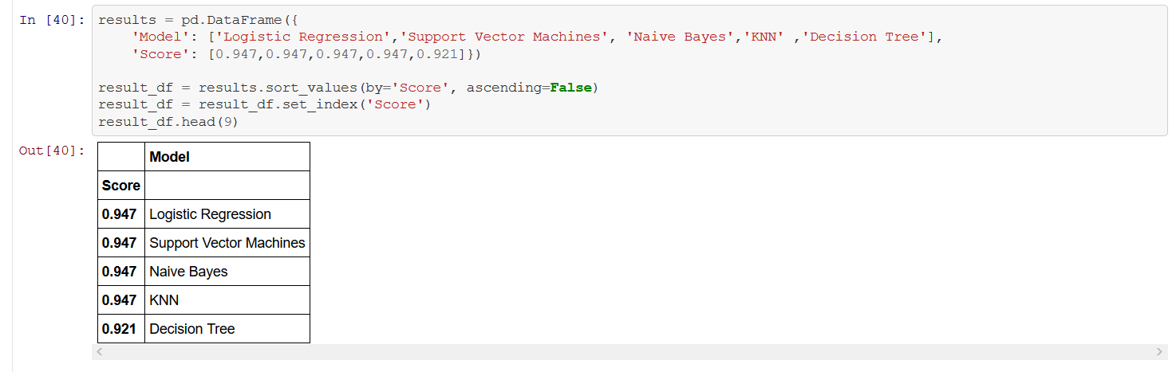
Final Evaluation Of All Models:

Slide 14
THANK YOU

